Slide 1

COMP-SCI 5590 - 0002 Special Topics
Mobile App development

Slide 2
Agenda
Introduction to Android
Getting Started
Android Programming

Slide 3
Introduction to Android
Popular mobile device OS
Developed by Open Handset Alliance, led by Google

Slide 4
What is Android
Android is an operating system for mobile devices such as smartphones and tablet computers. It is developed by the Open Handset Alliance led by Google.
Android has beaten Apple iOS, being the leading mobile operating system from first quarter of 2011
Version: Android 1.0, 1.1 to 1.5 (Cupcake), 1.6 (Donut), 2.0/2.1 (Eclair), 2.2 (Froyo), 2.3 (Gingerbread), to 3.0 (Honeycomb), 4.0 (Ice Cream Sandwich), 5.0 (Lollipop)

Slide 5
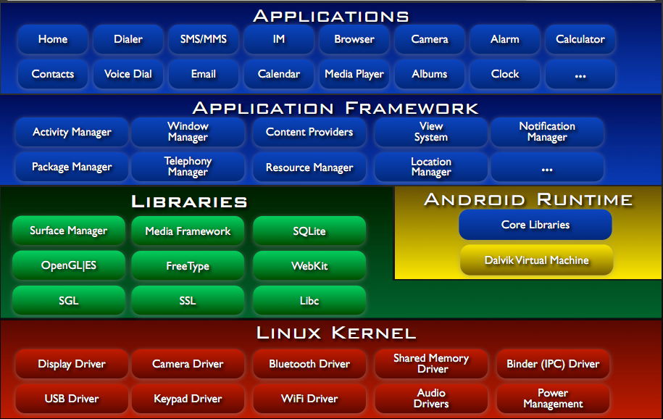
Android Architecture
Notes:
OpenGLJES handle the graphics
Surface Manager manages the pixel on screen
Dalvik Virtual Machine → modern form of JVM, due to limited battery, limited memory, limited processing, makes program faster can have multiple dalvik machine to run at same time
Application FrameWork → written in Java, for help in application
Package Manager → what kind of application the device have

Slide 6
Getting Started (1)
Need to install Java Development Kit (JDK) to write Java (and Android) programs
Do not install Java Runtime Environment (JRE); JDK and JRE are different!
Can download the JDK for your OS at http://java.oracle.com
Alternatively, for OS X, Linux:
OS X:
Open /Applications/Utilities/Terminal.app
Type javac at command line
Install Java when prompt appears
Linux:
Type sudo apt–get install default–jdk at command line (Debian, Ubuntu)
Other distributions: consult distribution’s documentation

Slide 7
Getting Started (2)
After installing JDK, download Android SDK from https://developer.android.com/studio/index.html
Simplest: download and install Android Studio bundle (including Android SDK) for your OS
Alternatives:
Download/install Android Developer Tools from this site (based on Eclipse)
Install Android SDK tools by themselves, then install ADT for Eclipse separately (from this site)
We’ll use Android Studio with SDK included (easy)

Slide 8
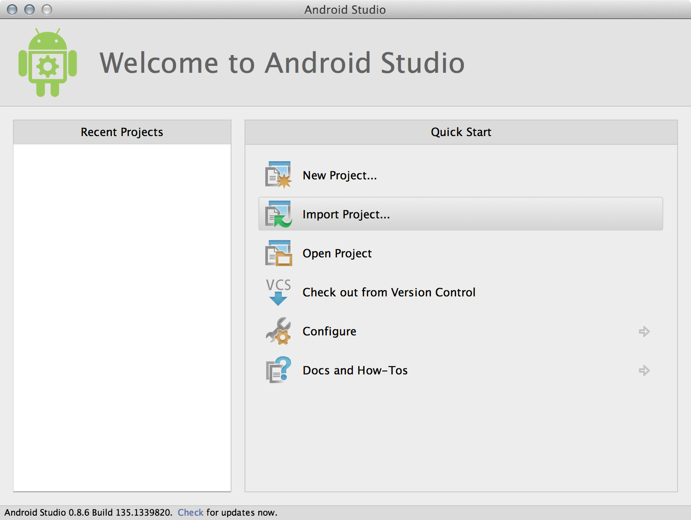
Getting Started (3)
Install Android Studio directly (Windows, Mac); unzip to directory android-studio, then run ./android-studio/bin/studio.sh (Linux)
You should see this:

Slide 9
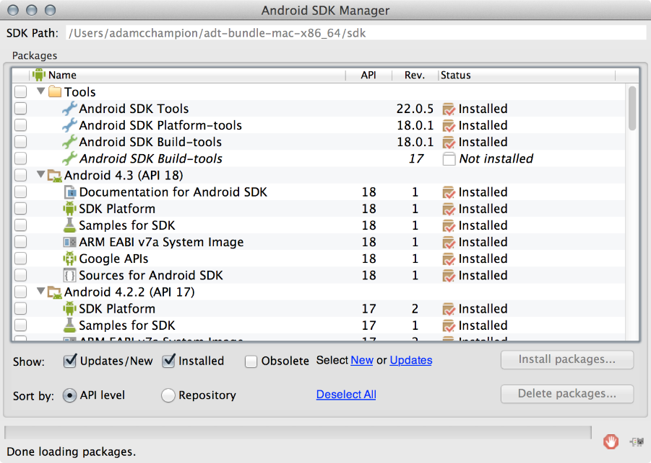
Getting Started
Strongly recommend testing with real Android device
Android emulator: very slow
Install USB drivers for your Android device!
Bring up the Android SDK Manager
Recommended: Install Android 2.2, 2.3.3 APIs and 4.x API
Do not worry about Intel x86 Atom, MIPS system images
Settings
Now you’re ready for Android development!

Slide 10
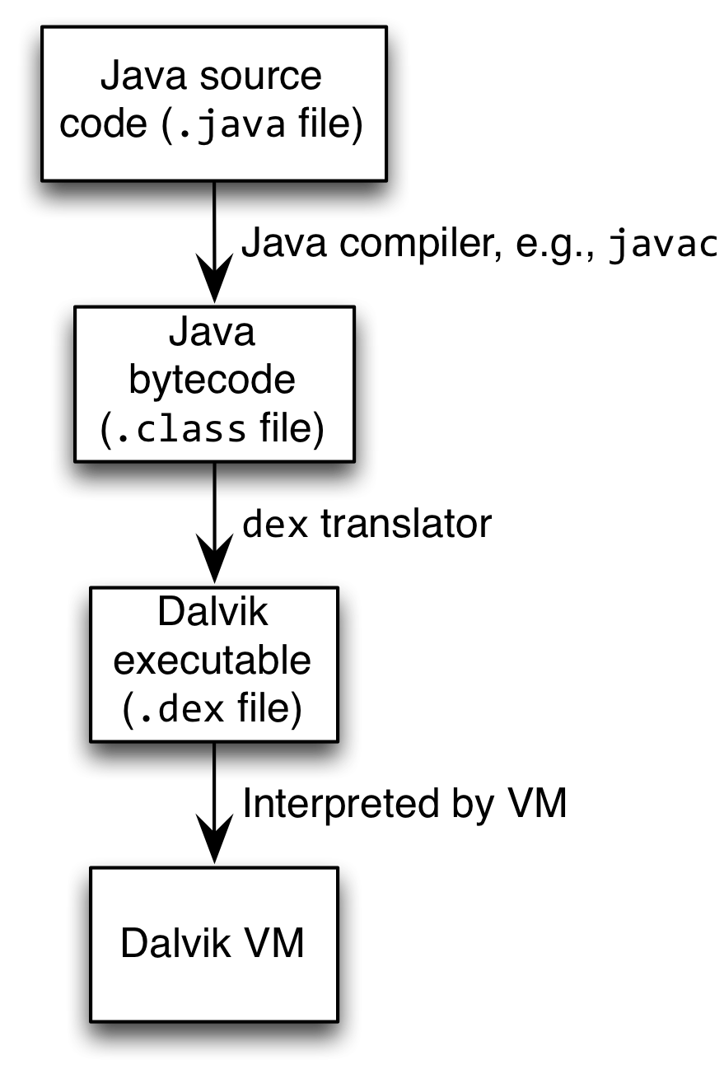
Android Highlights
Android apps execute on Dalvik VM, a “clean-room” implementation of JVM
Dalvik optimized for efficient execution
Dalvik: register-based VM, unlike Oracle’s stack-based JVM
Java .class bytecode translated to Dalvik Executable (DEX) bytecode, which Dalvik interprets

Slide 11
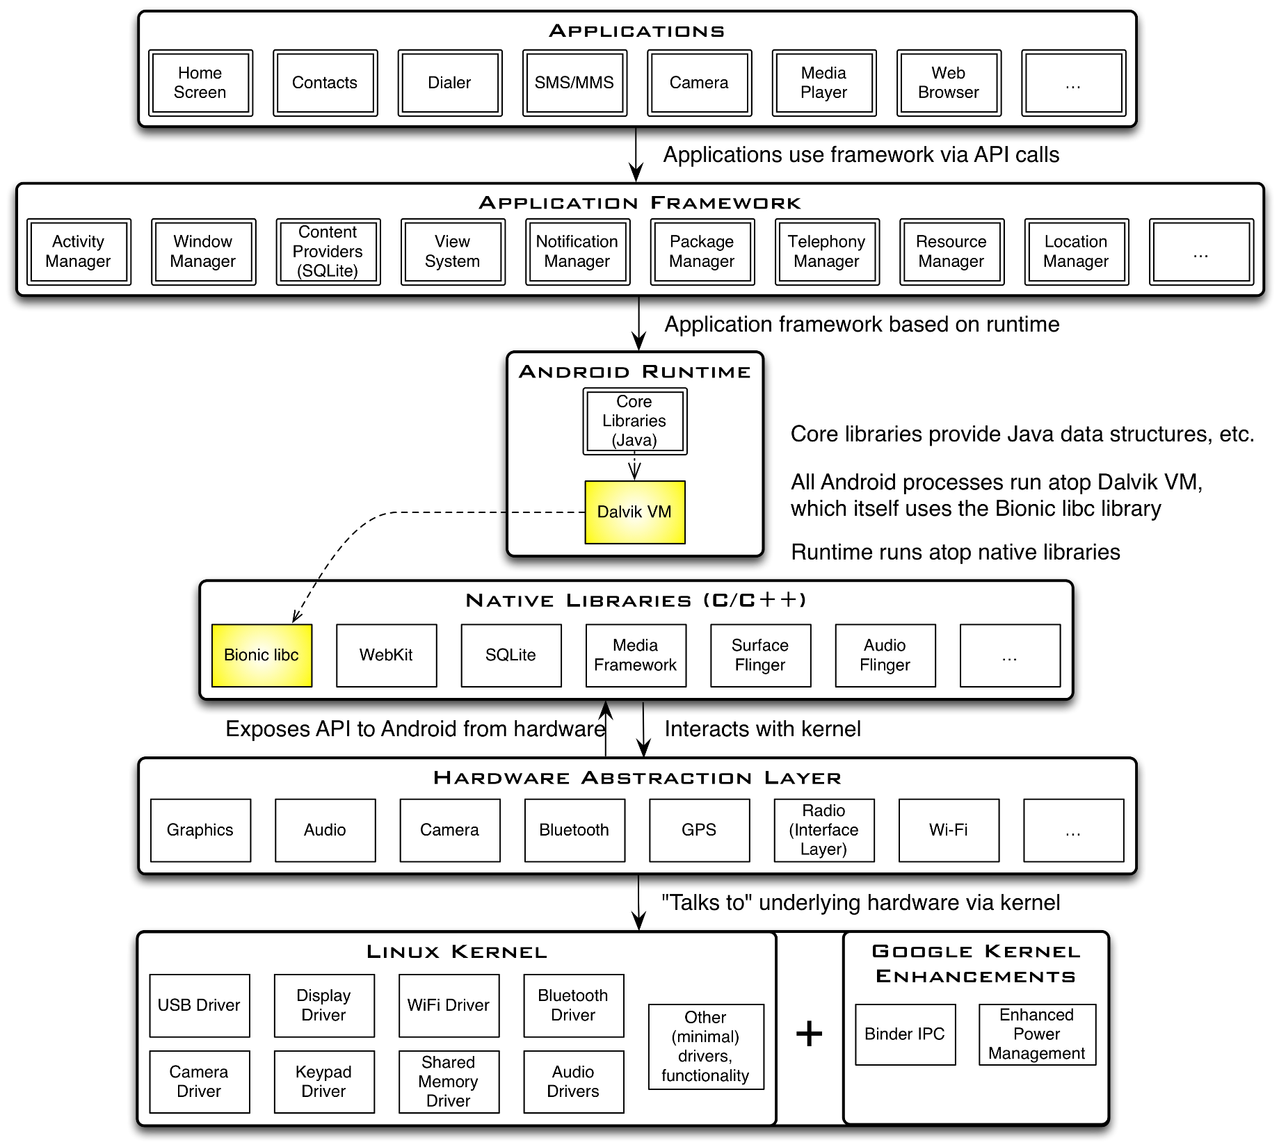

Slide 12
Android Highlights
Android apps written in Java 5
Actually, a Java dialect (Apache Harmony)
Everything we’ve learned still holds
Apps use four main components:
Activity: A “single screen” that’s visible to user
Service: Long-running background “part” of app (not separate process or thread)
ContentProvider: Manages app data (usually stored in database) and data access for queries
BroadcastReceiver: Component that listens for particular Android system “events”, e.g., “found wireless device”, and responds accordingly

Slide 13
App Manifest
Every Android app must include an AndroidManifest.xml file describing functionality
The manifest specifies:
App’s Activities, Services, etc.
Permissions requested by app
Minimum API required
Hardware features required, e.g., camera with autofocus
External libraries to which app is linked, e.g., Google Maps library
Notes:
Three important files
Manifest → xml file
Activity → java file
Layouts → xml file

Slide 14
Activity Lifecycle
Activity: key building block of Android apps
Extend Activity class, override onCreate(), onPause(), onResume() methods
Dalvik VM can stop any Activity without warning, so saving state is important!
Activities need to be “responsive”, otherwise Android shows user “App Not Responsive” warning:
Place lengthy operations in Runnable Threads, AsyncTasks
Source: [12]

Slide 15
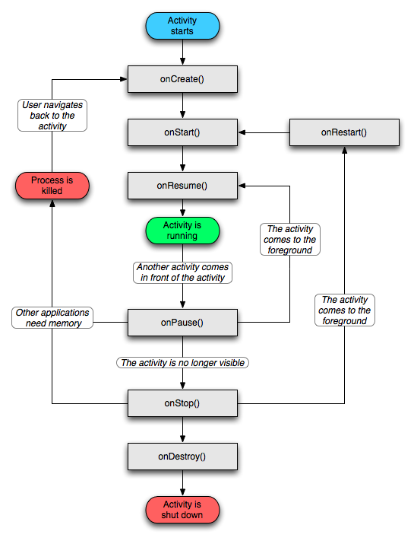

Slide 16
App Creation Checklist
If you own an Android device:
Ensure drivers are installed
Enable developer options on device under Settings, specifically USB Debugging
Android 4.2+: Go to Settings→About phone, press Build number 7 times to enable developer options
For Android Studio:
Under File→Settings→Appearance, enable “Show tool window bars”; the Android view shows LogCat, devices
Programs should log states via android.util.Log’s Log.d(APP_TAG_STR, “debug”), where APP_TAG_STR is a final String tag denoting your app
Other commands: Log.e() (error); Log.i() (info); Log.w() (warning); Log.v() (verbose) – same parameters

Slide 17
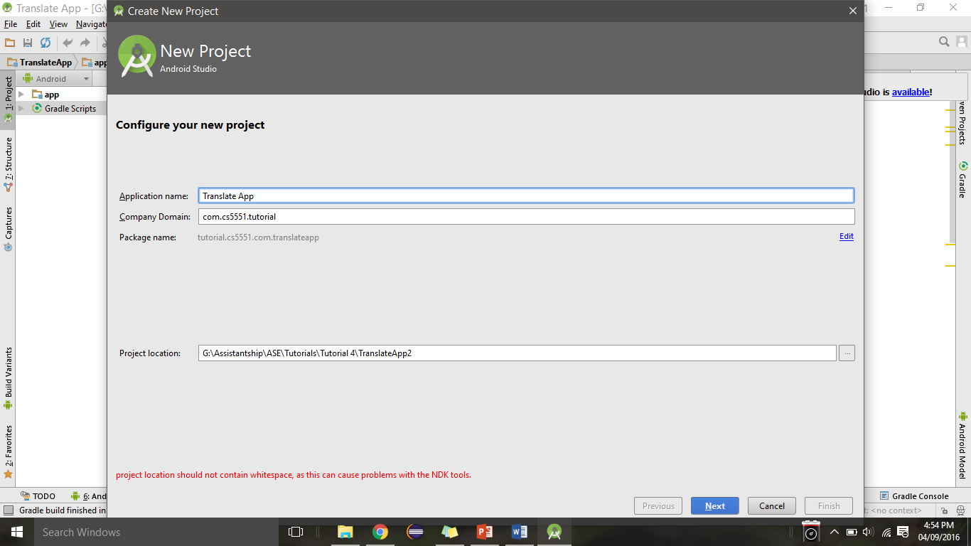
Creating Android App
Creating Android app project in Android Studio:
Go to File→New Project
Enter app, project name
Choose package name using “reverse URL” notation, e.g., edu.umkc.myapp
Select APIs for app, then click Next

Slide 18
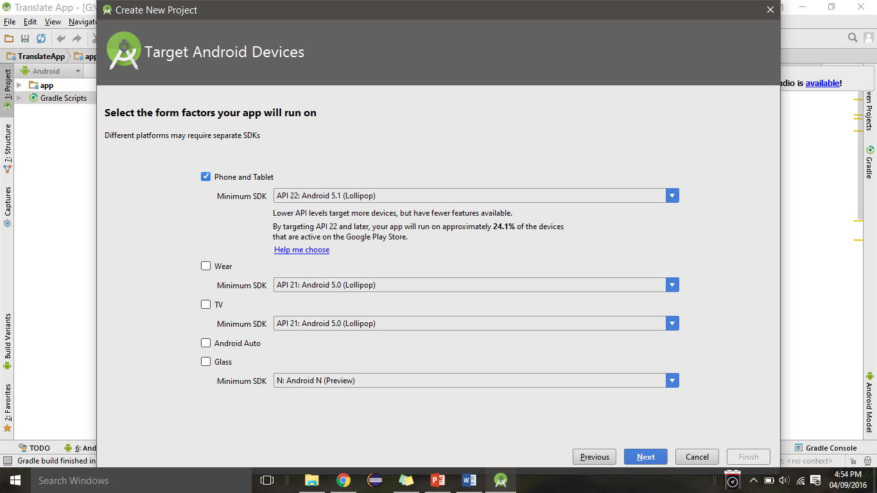
Selecting the SDK and type of device to deploy the application
1
2
The minimum SDK version that you want your app to run on. It is better to prefer a version that is stable and
new
2. In case you want your app to deployed on smart watches and other wearable device.

Slide 19
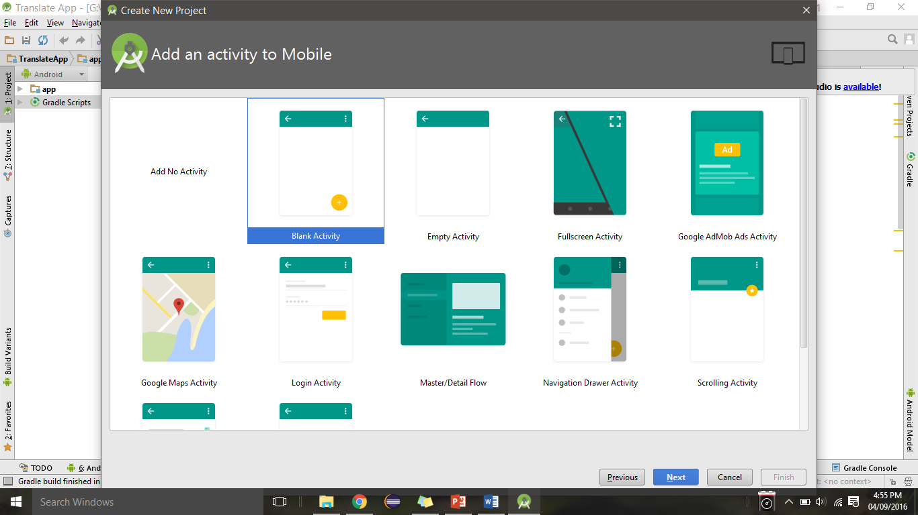
Selecting the type of activity for the application
You can choose from various templates available to start off the application. It is better to choose a
Blank activity as you could add and manage the controls as you need.

Slide 20
Creating Android App
Determine what kind of Activity to create; then click Next
We’ll choose a Blank Activity for simplicity
Enter information about your Activity, then click Finish
This creates a “Hello World” app

Slide 21
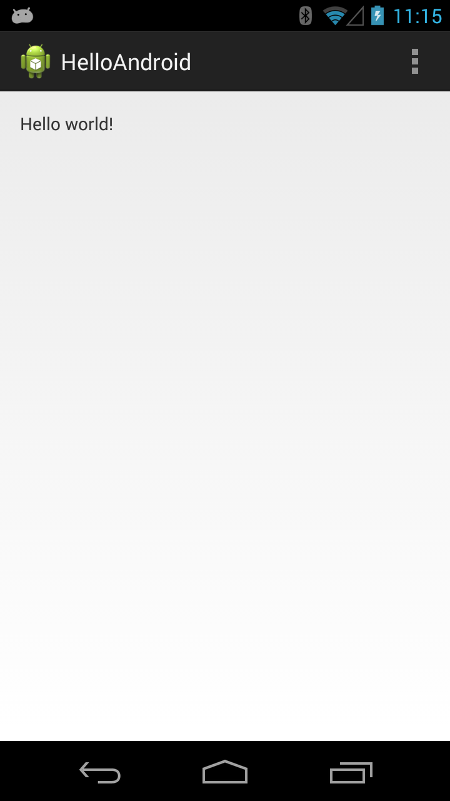
Deploying the App
Two ways:
Real Android device
Android virtual device
Plug in your real device; otherwise, create an Android virtual device
Emulator is slow. Try Intel accelerated version, or perhaps http://www.genymotion.com/
Run the app: press “Run” button in toolbar

Slide 22
Usecase 1:Source Code
src/…/MainActivity.java
package com.rashmi.android.umkc.edu.helloworldap;
import android.os.Bundle;
import android.app.Activity;
import android.view.Menu;
public class MainActivity extends Activity
{
@Override
protected void onCreate(Bundle savedInstanceState)
{
super.onCreate(savedInstanceState);
setContentView(R.layout.activity_main);
}
}
Oncreate() method

Slide 23
Underlying GUI Code
res/layout/activity_main.xml
<RelativeLayout xmlns:android="http://schemas.android.com/apk/res/android"
xmlns:tools="http://schemas.android.com/tools"
android:layout_width="match_parent"
android:layout_height="match_parent"
tools:context=".MainActivity" >
<TextView
android:layout_width="wrap_content"
android:layout_height="wrap_content"
android:text="Hello World !!"
android:layout_centerVertical="true"
android:layout_alignParentStart="true"
android:layout_marginStart="128dp"
android:id="@+id/textView" />
<Button
android:id="@+id/button"
android:layout_width="wrap_content"
android:layout_height="wrap_content"
android:layout_alignStart="@+id/textView"
android:layout_below="@+id/textView"
android:layout_marginTop="22dp"
android:text="OK" />
</RelativeLayout>
Textview
Button

Slide 24
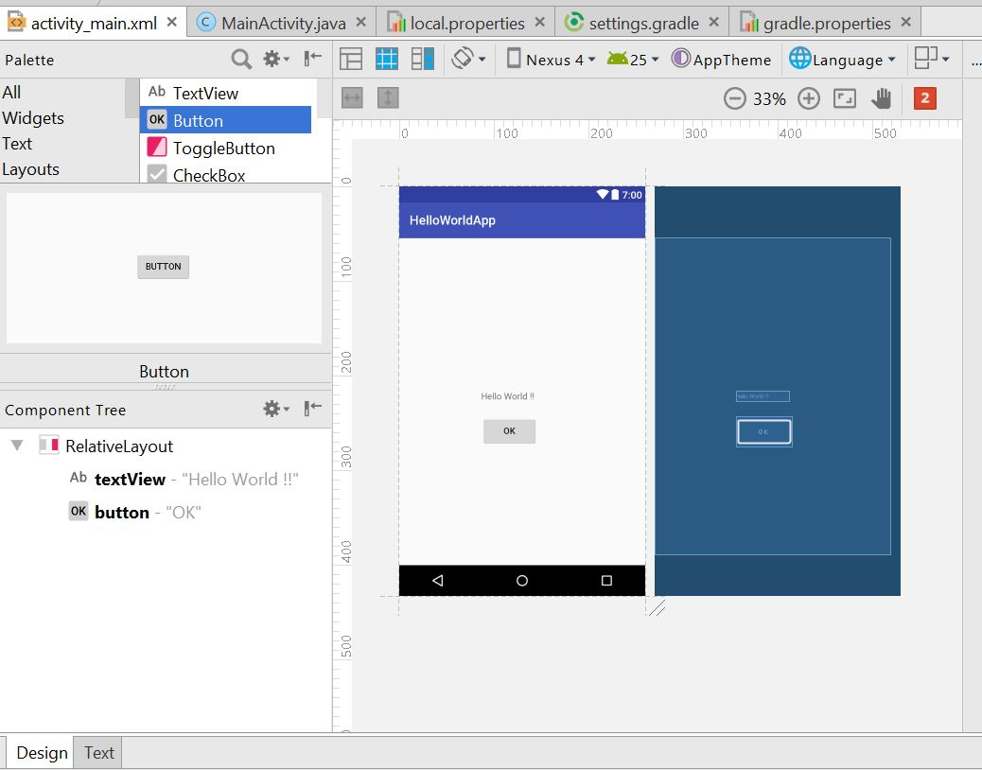
GUI Design
Button and text view
Layout Tree
Switch between XML and text form

Slide 25
The App Manifest
AndroidManifest.xml
<?xml version="1.0" encoding="utf-8"?> <manifest xmlns:android="http://schemas.android.com/apk/res/android" package="com.rashmi.android.umkc.edu.helloworldapp"> <application android:allowBackup="true" android:icon="@mipmap/ic_launcher" android:label="@string/app_name" android:roundIcon="@mipmap/ic_launcher_round" android:supportsRtl="true" android:theme="@style/AppTheme"> <activity android:name=".MainActivity"> <intent-filter> <action android:name="android.intent.action.MAIN" /> <category android:name="android.intent.category.LAUNCHER" /> </intent-filter> </activity> </application> </manifest>
Tells the main Java class which starts the application

Slide 26
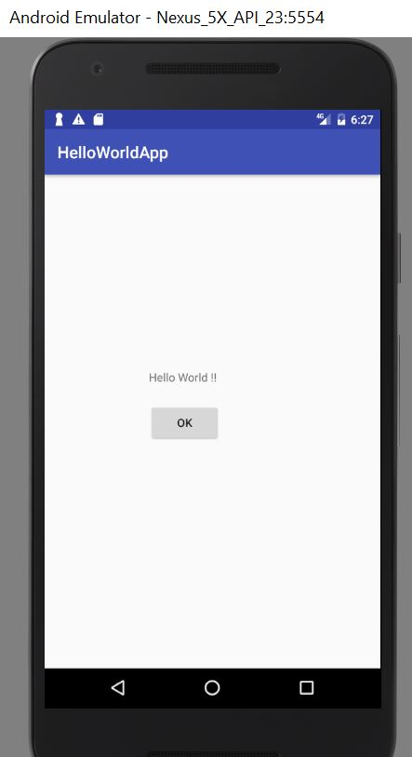
Output- Emulator

Slide 27
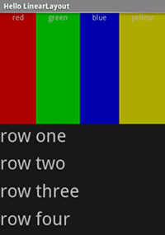
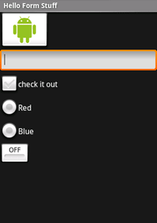
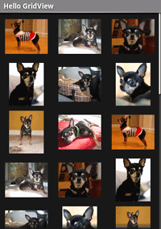
Views

Slide 28
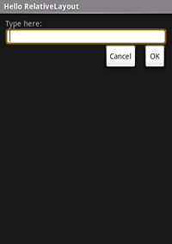
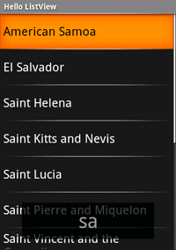
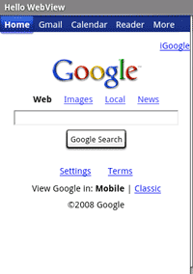
Views

Slide 29
Android Programming Notes
Android apps have multiple points of entry: no main() method
Cannot “sleep” in Android
During each entrance, certain Objects may be null
Defensive programming is very useful to avoid crashes, e.g., if (!(myObj == null)) { // do something }
Java concurrency techniques are required
Don’t block the “main” thread in Activities
Implement long-running tasks such as network connections asynchronously, e.g., as AsyncTasks
Logging state via android.util.Log throughout app is essential when debugging (finding root causes)
Better to have “too many” permissions than too few
Otherwise, app crashes due to security exceptions!
Remove “unnecessary” permissions before releasing app to public
Event handling in Android GUIs entails many listener Objects

Slide 30
References
http://web.cse.ohio-state.edu/~xuan.3/courses/5432/AndroidProgramming.ppt
https://doc.lagout.org/operating%20system%20/android/Android%20Application%20Development.ppt

Slide 31
Lets start with In class Exercise
Create manual Login App
Please refer steps in Lesson plan.

Slide 32

Thank you.....

